Slide 1
The Problem
How might we help students quickly discover reliable academic resources that align with their course requirements?
How might we help students instantly discover reliable resources aligned to their course?
"Notes in a classmate's Drive. Past papers in a Telegram group. Textbooks behind a paywall. And exams in 48 hours. Sound familiar?"
New Era Of AI

Slide 2
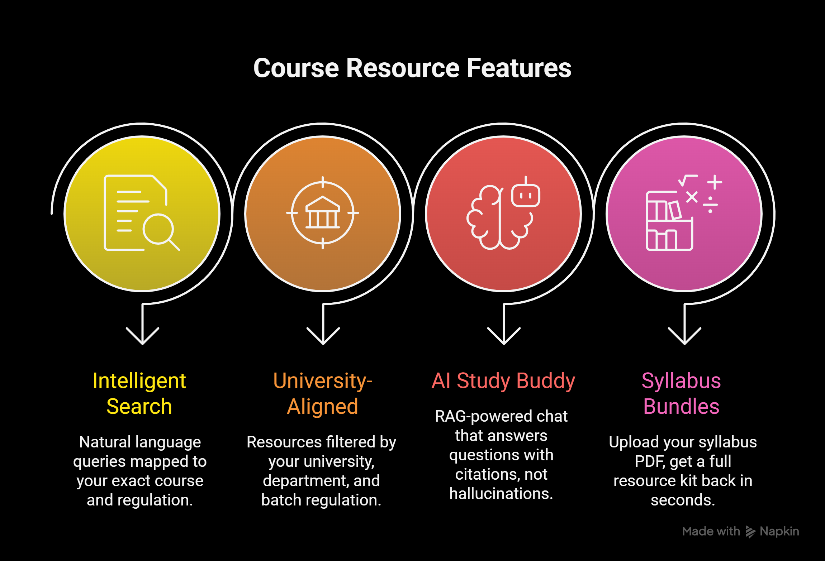
Edu Find AI — Your academic co-pilot, powered by AI

Slide 3
The Workflow
.
From Query to Answer in Under a minute
5-step flow:
1.You Ask → "Find me Data Structures Unit 3 notes, JNTUH R20"
2.We Parse → AI extracts university, regulation, subject, unit, resource type
3.We Retrieve → Vector search across 50,000+ indexed resources filtered by your regulation
4.We Rank → Official university resources first, then community + AI credibility score
5.You Study → Ranked cards with direct links, summaries, download buttons
Credibility Fingerprint™ — every resource scored on source authority + syllabus alignment + community rating. No more guessing if it's reliable

Slide 4
Our Uniqueness
The Resource Finder — What It Actually Surfaces
The finder doesn't just return one type of resource. For any given topic search, it actively looks across 3 resource categories simultaneously:
Notes , ppts, lectures.
Regulation-Aligned Discovery:
Scrape it — We crawl your university's site for your specific regulation (R20, R22, CBCS). Notes, PPTs, past papers, and textbooks are extracted, structured by Gemini or Groq, and returned ready to open or download.
Search for accurate resources:
Our website extracts the regulations and analyses them And finds the resources similar and match to the extracted ones

Slide 5
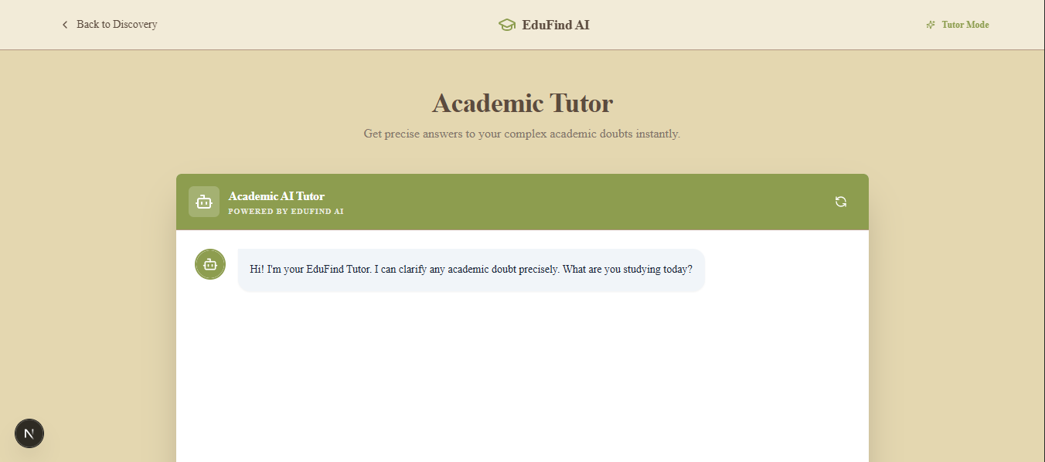
Personalised Chatbot
A chatbot finely tuned for personalized responses and a problem solver

